Slide 1

Key Developments and Innovations in K-12 Pedagogy
Exploring transformative trends enhancing education today
Notes:
AI-generated content may be incorrect. --- This presentation explores the latest trends and transformative innovations shaping K-12 education. We will cover personalized learning, technology integration, social-emotional learning, and more, highlighting how these approaches enhance teaching and learning experiences. Image source: Microsoft 365 content library

Slide 2

Presentation Agenda Overview
Personalized and Competency-Based Learning
Integration of Technology and Artificial Intelligence
Social and Emotional Learning (SEL)
Inquiry-Based and Project-Based Learning
Focus on Equity, Diversity, and Inclusion
Assessment and Feedback
Interdisciplinary and STEAM Education
Professional Development, Collaboration, and Community Engagement
Notes:
--- Our agenda covers eight key areas: personalized and competency-based learning, technology and AI integration, social and emotional learning, inquiry and project-based learning, equity and inclusion, assessment and feedback, interdisciplinary STEAM education, and professional development with community engagement. Image source: Microsoft 365 content library

Slide 3
Personalized and Competency-Based Learning
Notes:
Shift toward personalized and competency-based education, Role of digital tools and adaptive technologies in personalization

Slide 4
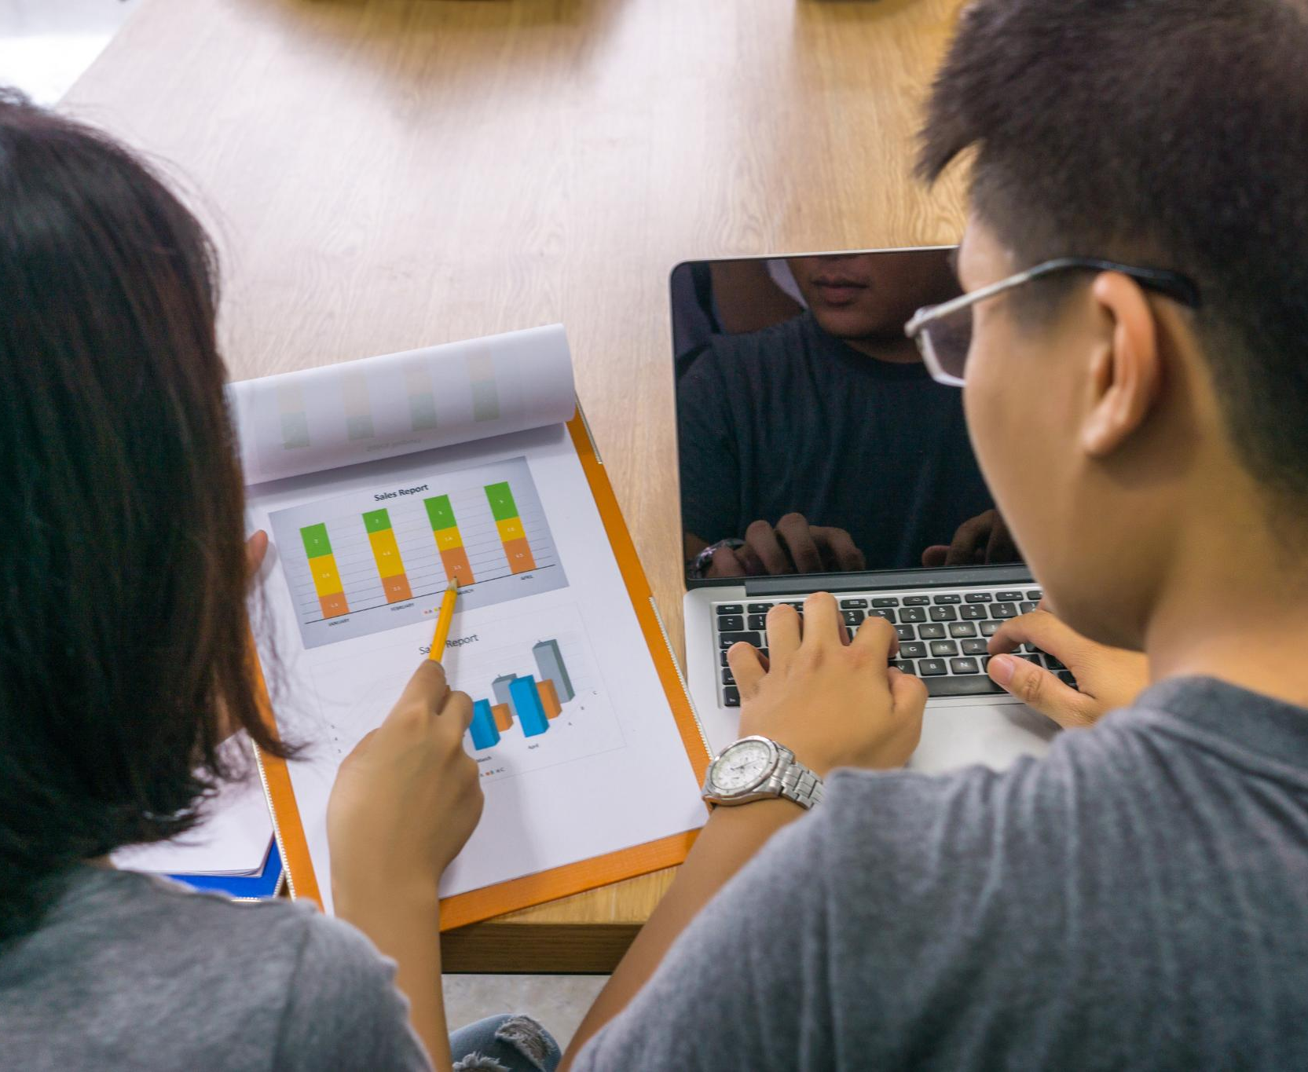
Shift toward personalized and competency-based education
Personalized Learning Approach
Instruction is tailored to each student's unique strengths, needs, and interests for better engagement.
Competency-Based Progression
Students advance by demonstrating mastery of skills, not by time spent in class.
Notes:
--- One of the most profound shifts in K-12 pedagogy is the move toward personalized and competency-based learning. Unlike traditional models, where all students advance at the same pace, personalized learning tailors instruction to each student’s strengths, needs, and interests. Competency-based education (CBE) goes a step further, allowing students to progress upon demonstrating mastery of specific skills or knowledge, regardless of time spent on a subject. Image source: Microsoft 365 content library

Slide 5
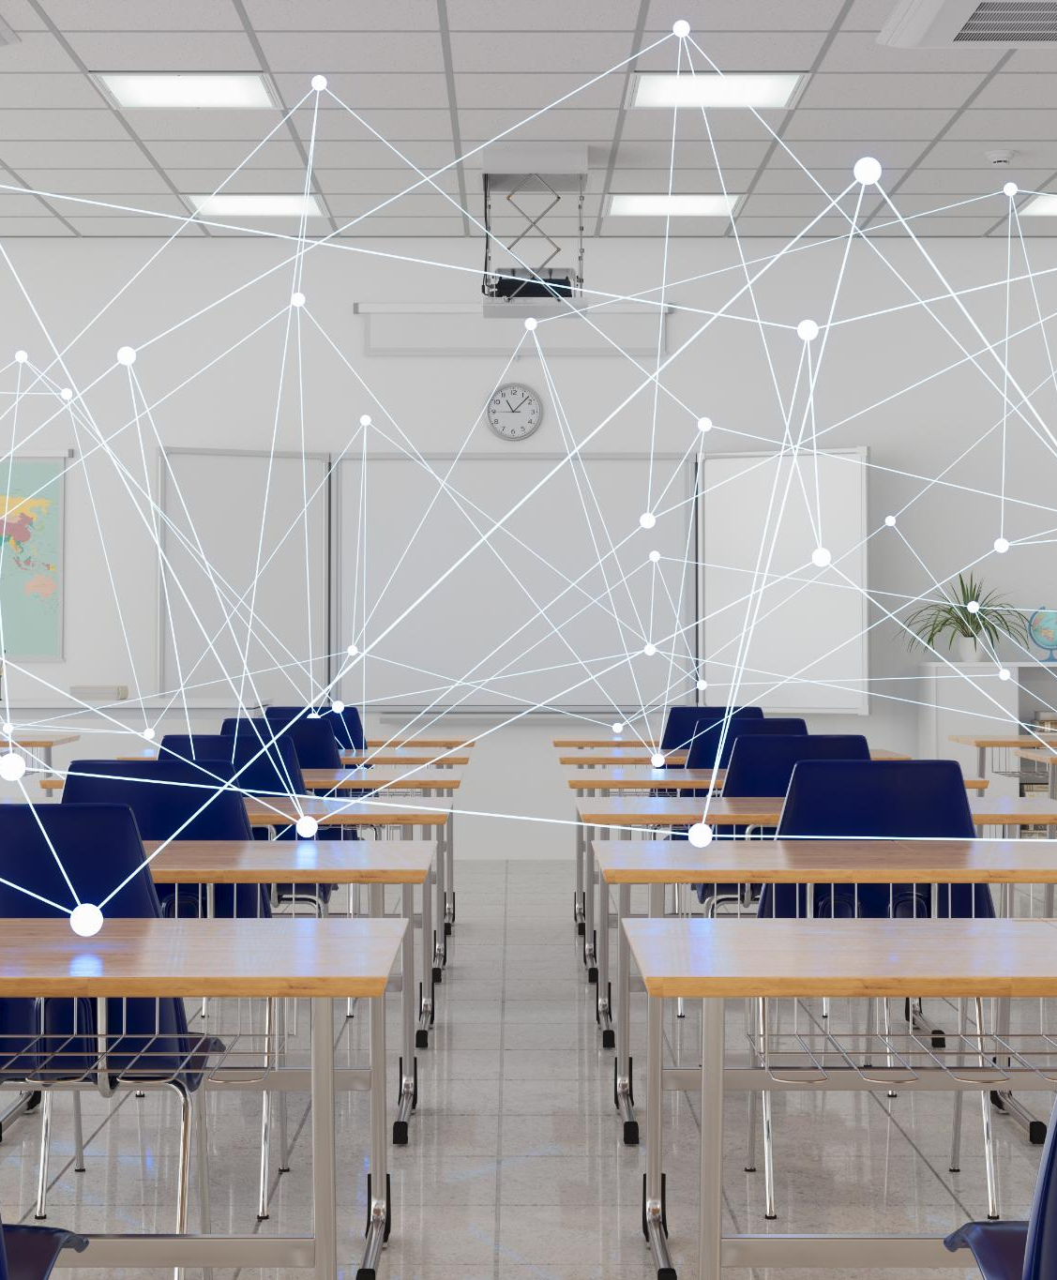
Role of digital tools and adaptive technologies in personalization
Real-Time Data Access
Digital tools enable teachers to access real-time data for adjusting lessons and providing targeted support.
AI-Powered Adaptive Learning
Adaptive technologies use AI to assess progress and deliver customized content for each learner.
Balanced Challenge for Learners
Personalized learning ensures students stay challenged without feeling overwhelmed.
Notes:
--- Digital tools and platforms have made personalization more feasible. Teachers can now access real-time data to adjust lessons, provide targeted interventions, and offer enrichment opportunities. Adaptive learning technologies, powered by artificial intelligence, assess student progress and deliver customized content, ensuring that learners remain challenged but not overwhelmed. Image source: Microsoft 365 content library

Slide 6
Integration of Technology and Artificial Intelligence
Notes:
Expansion of technology in K-12 pedagogy and hybrid learning models, Applications of artificial intelligence in education, Challenges of equitable access and data privacy

Slide 7

Expansion of technology in K-12 pedagogy and hybrid learning models
Increased Technology Integration
Technology has become a fundamental part of K-12 teaching methods, enhancing engagement and accessibility for students.
Pandemic-Driven Online Learning
Educators adapted rapidly to online learning during the pandemic, ensuring continuity of education remotely.
Adoption of Hybrid Learning Models
Hybrid models combining in-person and digital instruction are now widely used to provide flexible learning experiences.
Notes:
--- Technology’s role in K-12 pedagogy has expanded dramatically. During the pandemic, educators pivoted quickly to online and blended learning. Even as students return to physical classrooms, many schools now use hybrid models that combine in-person and digital instruction. Image source: Microsoft 365 content library

Slide 8
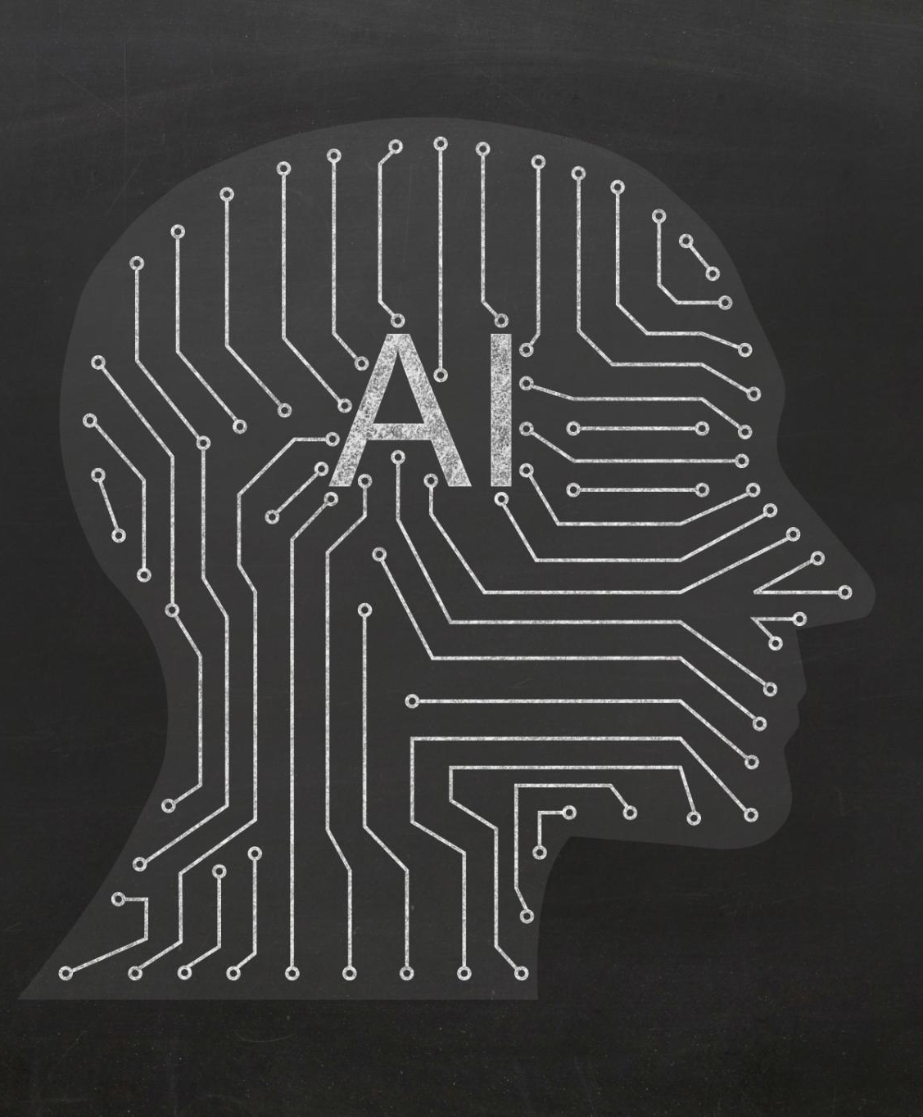
Applications of artificial intelligence in education
AI Tutoring Systems
AI-driven tutoring systems provide immediate feedback to students, enhancing classroom instruction effectively.
Adaptive Learning Tools
Intelligent assistants and problem solvers adapt to learners’ levels, offering personalized support or progression.
Formative Assessment Support
AI supports formative assessments with interactive quizzes, games, and simulations giving teachers actionable insights.
Notes:
--- Artificial intelligence (AI) is increasingly present in educational contexts. AI-driven tutoring systems can offer immediate feedback, supplementing classroom instruction. Tools like intelligent writing assistants, math problem solvers, and language learning platforms adapt to the learner’s level, providing scaffolding or acceleration as needed. Technology also supports formative assessment through interactive quizzes, games, and simulations, giving teachers actionable insights. Image source: Microsoft 365 content library

Slide 9

Challenges of equitable access and data privacy
Equitable Access Challenges
Many students lack reliable internet or devices, creating gaps in educational opportunities and digital learning.
Data Privacy Concerns
Protecting student data privacy is crucial to prevent misuse of sensitive information in digital learning environments.
Notes:
--- However, these advances come with challenges, such as ensuring equitable access and protecting student data privacy. Closing the digital divide remains a key concern, as students without reliable internet or devices are at risk of falling behind. Image source: Microsoft 365 content library

Slide 10
Social and Emotional Learning (SEL)
Notes:
Importance of SEL in modern pedagogy, Embedding SEL strategies and trauma-informed practices

Slide 11
Importance of SEL in modern pedagogy
Academic and Emotional Integration
Modern education links academic achievement closely with social and emotional development.
Global SEL Integration
SEL programs are widely implemented in curricula worldwide to enhance students’ social skills.
Core SEL Skills
SEL emphasizes self-awareness, self-management, relationship-building, and responsible decision-making skills.
Notes:
--- Modern pedagogy recognizes that academic achievement is inseparable from social and emotional development. Social and Emotional Learning (SEL) programs are now integrated into curricula across the globe. SEL focuses on skills like self-awareness, self-management, relationship-building, and responsible decision-making. Image source: Microsoft 365 content library

Slide 12
Inquiry-Based and Project-Based Learning
Notes:
Adoption of inquiry-based and project-based learning approaches, Real-world applications and development of soft skills

Slide 13

Adoption of inquiry-based and project-based learning approaches
Shift to Active Learning
Inquiry-based and project-based learning focus on active student exploration rather than passive fact absorption.
Critical Thinking and Collaboration
These approaches encourage critical thinking skills and teamwork among students through collaborative problem solving.
Real-World Connections
Projects often connect learning to real-world issues, enhancing relevance and creativity in education.
Notes:
--- A growing number of schools are embracing inquiry-based and project-based learning (PBL) approaches. These pedagogies shift the focus from passive absorption of facts to active exploration, critical thinking, and collaboration. Students engage in hands-on projects that require research, problem-solving, and creativity, often connected to real-world issues. Image source: Microsoft 365 content library

Slide 14

Real-world applications and development of soft skills
Inquiry-based Learning
Students ask questions and seek evidence to build understanding through inquiry-based learning.
Project-Based Learning Activities
PBL projects include designing solutions to environmental issues and creating multimedia presentations.
Soft Skills Development
These learning methods promote engagement and help develop soft skills valued by employers.
Notes:
--- Inquiry-based learning encourages students to ask questions, seek evidence, and construct understanding. PBL units might involve designing solutions to local environmental problems, creating multimedia presentations, or collaborating with community partners. These methods foster engagement, deepen learning, and help students develop the “soft skills” valued by employers. Image source: Microsoft 365 content library

Slide 15
Focus on Equity, Diversity, and Inclusion
Notes:
Centrality of equity in K-12 pedagogy and culturally responsive teaching, Addressing opportunity gaps and professional development in anti-bias education

Slide 16

Centrality of equity in K-12 pedagogy and culturally responsive teaching
Focus on Educational Equity
Equity is central to K-12 pedagogy, ensuring fair access and opportunities for all students regardless of background.
Re-examining School Practices
Schools revisit curricula, discipline, and assessments to better serve marginalized and diverse student populations.
Culturally Responsive Teaching
Instruction connects to students’ lived experiences, values diverse identities, and broadens cultural perspectives.
Notes:
--- Equity has become central to conversations about K-12 pedagogy. Schools are re-examining curricula, disciplinary practices, and assessment methods to better serve all students, particularly those from historically marginalized groups. Culturally responsive teaching aims to connect instruction to students’ lived experiences, validate diverse identities, and broaden perspectives. Image source: Microsoft 365 content library

Slide 17

Addressing opportunity gaps and professional development in anti-bias education
Universal Design for Learning
UDL techniques help create flexible learning environments to accommodate diverse student needs effectively.
Multilingual and Differentiated Instruction
Multilingual education and differentiated instruction address individual learning gaps and language diversity.
Anti-Bias Professional Development
Training in anti-bias education and trauma-informed practices supports educators in fostering equitable classrooms.
Notes:
--- Efforts to address opportunity gaps include universal design for learning (UDL), multilingual education, and differentiated instruction. Professional development in anti-bias education and trauma-informed practices is now widespread. The goal is to ensure that every student has access to high-quality learning opportunities and support systems. Image source: Microsoft 365 content library

Slide 18
Assessment and Feedback
Notes:
Re-evaluation of standardized testing and emphasis on multiple measures, Use of digital portfolios and new assessment models

Slide 19

Re-evaluation of standardized testing and emphasis on multiple measures
Criticism of Standardized Testing
Traditional standardized tests are being questioned for limited insight into student learning and growth.
Multiple Measures Approach
Assessment now includes portfolios, performance tasks, and varied evidence to capture student abilities more fully.
Formative Feedback Emphasis
Ongoing feedback guides student improvement and learning rather than just assigning final grades.
Notes:
--- Traditional standardized testing is being re-evaluated. Many educators and policymakers now advocate for multiple measures of student learning, including portfolios, performance assessments, and formative feedback. The movement toward “assessment for learning” emphasizes ongoing feedback that guides student growth, rather than simply assigning grades. Image source: Microsoft 365 content library

Slide 20
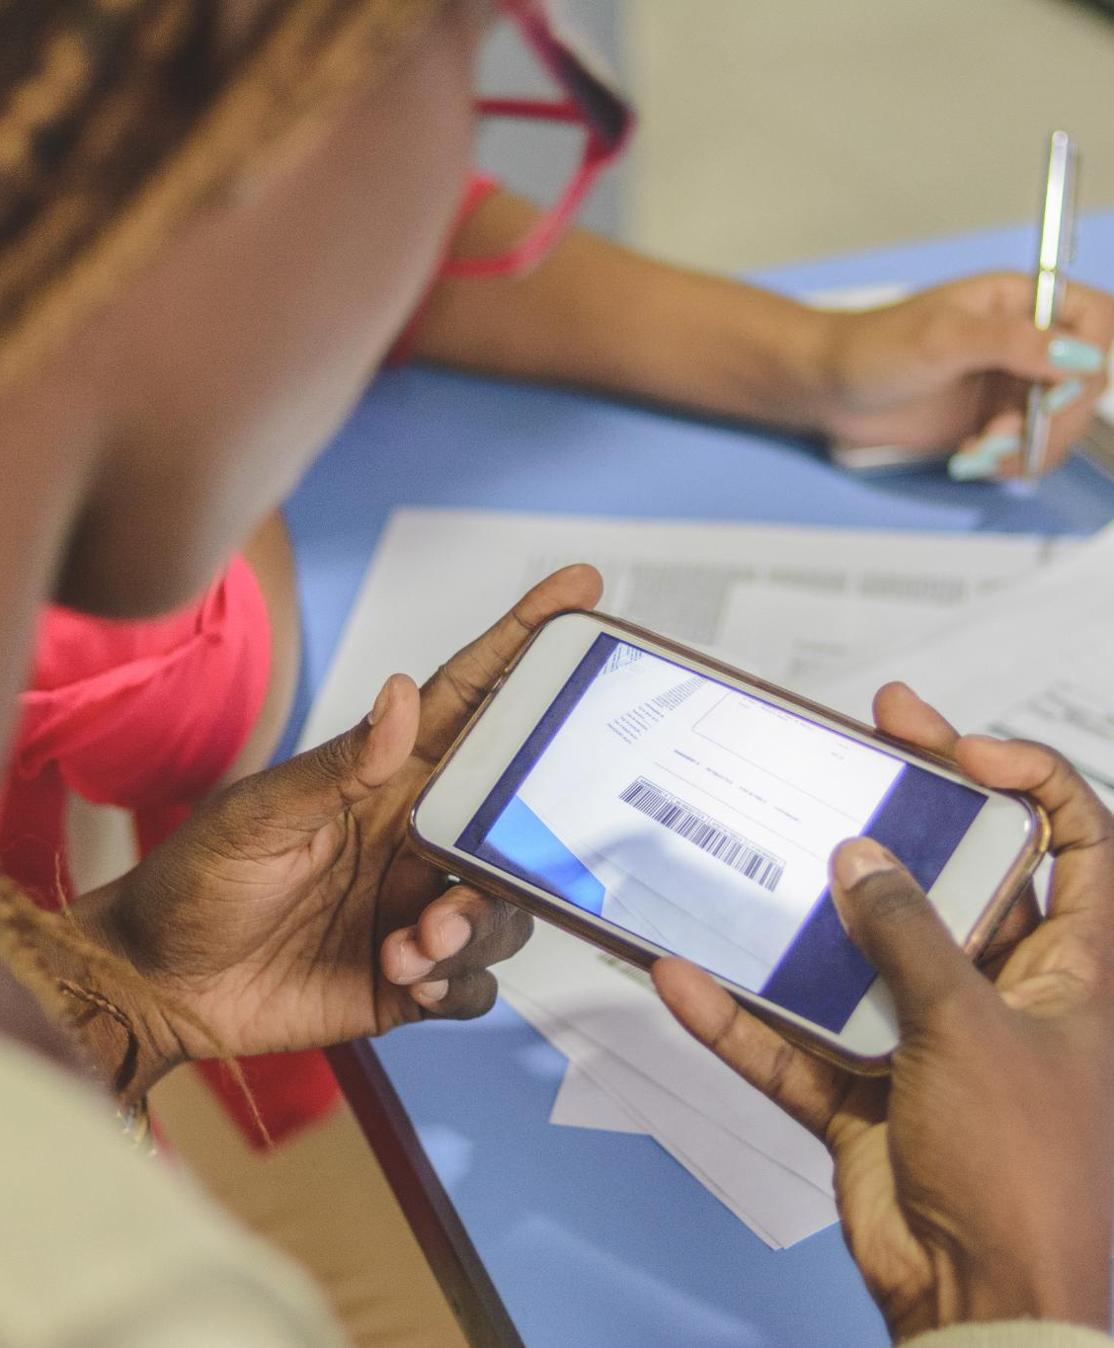
Use of digital portfolios and new assessment models
Digital Portfolios
Digital portfolios enable students to document and reflect on their learning progress over time.
Peer and Self-Assessment
Peer and self-assessment promote metacognition and personal responsibility in the learning process.
New Assessment Models
New models measure creativity, collaboration, and complex skills beyond traditional tests.
Notes:
--- Digital portfolios allow students to collect and reflect on their work over time. Peer and self-assessment encourage metacognition and responsibility for learning. New assessment models also seek to measure creativity, collaboration, and other complex skills not captured by conventional tests. Image source: Microsoft 365 content library

Slide 21
Interdisciplinary and STEAM Education
Notes:
Growth of interdisciplinary approaches and STEAM integration, Maker spaces, robotics, and art-infused science projects

Slide 22
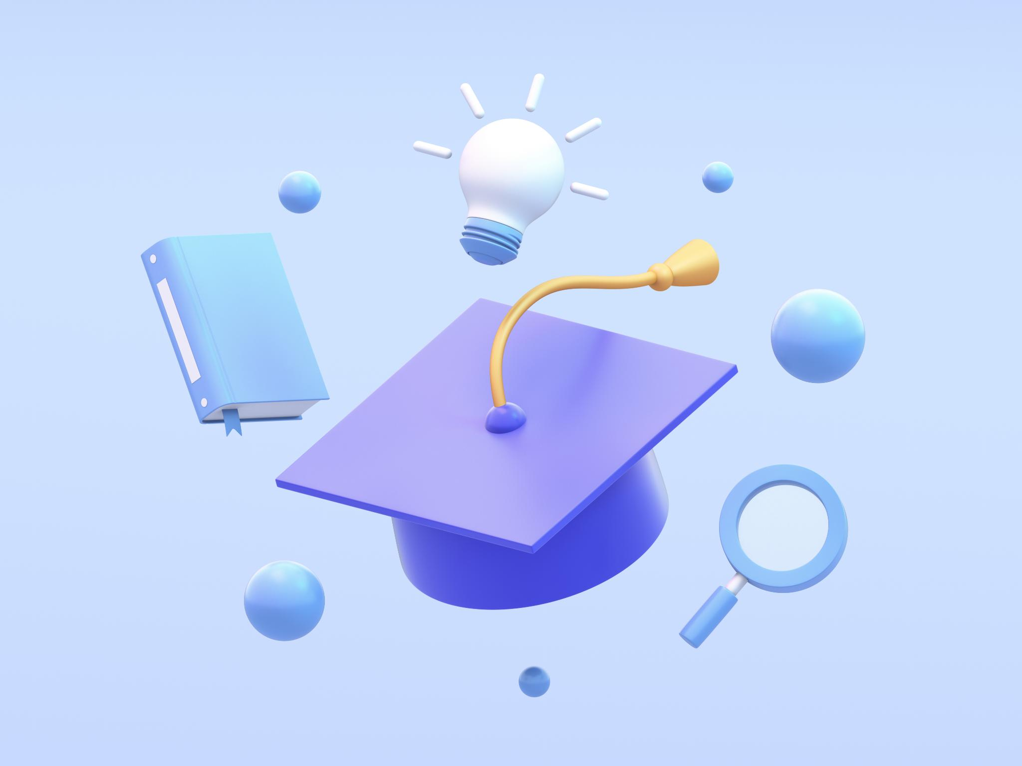
Growth of interdisciplinary approaches and STEAM integration
Interdisciplinary Education Growth
Modern education increasingly connects multiple disciplines to reflect real-world knowledge interconnection and complexity.
STEAM Integration Benefits
Integrating arts into STEM enhances creativity, innovation, and holistic problem-solving skills among learners.
Notes:
--- Education is becoming more interdisciplinary, reflecting the interconnectedness of knowledge in the 21st century. STEAM education (Science, Technology, Engineering, Arts, Mathematics) integrates the arts into traditional STEM fields, promoting creativity, innovation, and holistic problem-solving. Image source: Microsoft 365 content library

Slide 23

Maker spaces, robotics, and art-infused science projects
Maker Spaces and Robotics Clubs
Maker spaces and robotics clubs offer hands-on experiences that encourage creativity and technical skills among students.
Coding Initiatives
Coding initiatives empower students to develop computational thinking and problem-solving abilities through programming activities.
Art-Infused Science Projects
Integrating art into science projects enriches learning by supporting diverse modes of expression and engaging varied learner interests.
Notes:
--- Recent developments include maker spaces, robotics clubs, coding initiatives, and art-infused science projects. These experiences help students connect concepts across subjects and apply their learning in authentic contexts. The integration of arts supports multiple modes of expression and appeals to a wider range of learners. Image source: Microsoft 365 content library

Slide 24
Professional Development, Collaboration, and Community Engagement
Notes:
Teacher professional development and collaboration models, Coaching, mentorship, and personalized professional learning, Family and community engagement initiatives

Slide 25

Teacher professional development and collaboration models
Professional Learning Communities
PLCs enable educators to collaborate, share best practices, and analyze student data for improved teaching outcomes.
Ongoing Professional Development
Continuous training focuses on new teaching methods, technology use, cultural responsiveness, and social-emotional learning.
Notes:
--- Effective pedagogy depends on well-prepared and continuously supported teachers. Professional learning communities (PLCs) are now common, enabling educators to collaborate, share best practices, and analyze student data together. Ongoing professional development focuses on new pedagogical approaches, technology integration, culturally responsive instruction, and SEL. Image source: Microsoft 365 content library

Slide 26

Coaching, mentorship, and personalized professional learning
Individualized Teacher Support
Coaching and mentorship offer tailored guidance to teachers throughout their career development stages.
Personalized Professional Development
Professional learning is increasingly customized, mirroring personalized approaches used in student education.
Notes:
--- Coaching models and mentorship programs provide individualized support for teachers at all career stages. Increasingly, professional development is personalized, reflecting the same principles being applied to student learning. Image source: Microsoft 365 content library

Slide 27

Family and community engagement initiatives
Importance of Partnerships
Effective collaboration between schools, families, and communities is vital for improving student success and learning outcomes.
Family Engagement in Learning
Initiatives encourage families to actively participate in education by sharing knowledge and supporting learning at home.
Community Connections
Community-based projects, service learning, and internships link classroom lessons with real-world experiences outside school.
Notes:
--- Strong partnerships between schools, families, and communities are recognized as essential for student success. Recent initiatives aim to engage families as active partners in the learning process, leveraging their knowledge and resources. Community-based projects, service learning, and internships connect classroom work to the world beyond school walls. Image source: Microsoft 365 content library

Slide 28
Conclusion
Personalized Learning
Personalized learning tailors education to meet individual student needs, enhancing engagement and outcomes.
Technology Integration
Technology integration supports innovative teaching methods and digital literacy development in classrooms.
Social-Emotional Learning (SEL)
SEL fosters emotional intelligence and social skills essential for student well-being and success.
Equity and Inclusion
Equity focus ensures all students have access to fair and inclusive education opportunities.
Notes:
K-12 pedagogy is rapidly evolving through personalized learning, technology integration, SEL, equity focus, and innovative teaching methods. These developments aim to create inclusive, engaging, and effective education for all students.

